Slide 1
DIP YOUR TOE INTO ONLINE TEACHING
Tools and tips for starting to teach online
Natalia Kurikova
nataliakurikova.com

Slide 2
Now you should be able to hear my voice. Assess how well you can hear me:
⬧
5 – Perfect
4 – Too much noise
3 – Too quiet
2 – Too loud
1 – No sound at all

Slide 3

GETTING TO KNOW YOU
Where are you from?
Are you joining the webinar from your home or workplace?
What can you see around you right now?

Slide 4

ABOUT THE SPEAKER
Natalia Kurikova – English language instructor, online tutor
Teaching English since 2008 in private language schools and at university level
Teaching online since 2015
Successfully prepared students to IELTS, TOEFL and Russian State Exam fully online

Slide 5
WEBINAR GROUND RULES to ensure that everyone has a pleasant experience
Minimize distractions (close other browser tabs, close the door, turn off the sound of you mobile phone if possible)
Actively participate in the webinar: answer the questions and take part in surveys
Do not hesitate to ask questions - there are no silly ones

Slide 6
DIP YOUR TOE INTO ONLINE TEACHING
Tools and tips for starting to teach online

Slide 7
OBJECTIVES
By the end of the webinar, you will be able to
Identify a range of hardware devices and software tools and how these can be used to support online learning
Select tools according to their contextual factors
Identify the differences and similarities between face-to-face and online teaching
Analyse affordances and constraints of online synchronous learning and become aware of the strategies and techniques to facilitate it
Consider your next steps towards becoming an online teacher

Slide 8
YOUR EXPECTATIONS
Type what you expect to learn during the webinar or a question that you have about online learning

Slide 9
AGENDA
Hardware for teaching online
Webcams: advantages, disadvantages, good practice
Communication tools
Online teaching skills
Tools to support teaching
Your questions

Slide 10
HARDWARE
Select all that applies to you
To access the webinar I am using
A desktop computer
A laptop
A tablet
A smartphone
To listen to the speaker I am using
The built-in speakers of my device (desktop/laptop/tablet/smartphone)
Standalone speakers
Headphones
Headset
Right, what am I using?...Hm… Not sure
What about a webcam?
I don’t have a webcam
I have a webcam but rarely use it
I have a webcam and often use it

Slide 11

HARDWARE
Computer: laptop/desktop/tablet
Internet connection: Cable/DSL
Audio: Headset / microphone+headphones (USB)
Video: Webcam

Slide 12


AUDIO
HEADSET
HEADPHONES

Slide 13
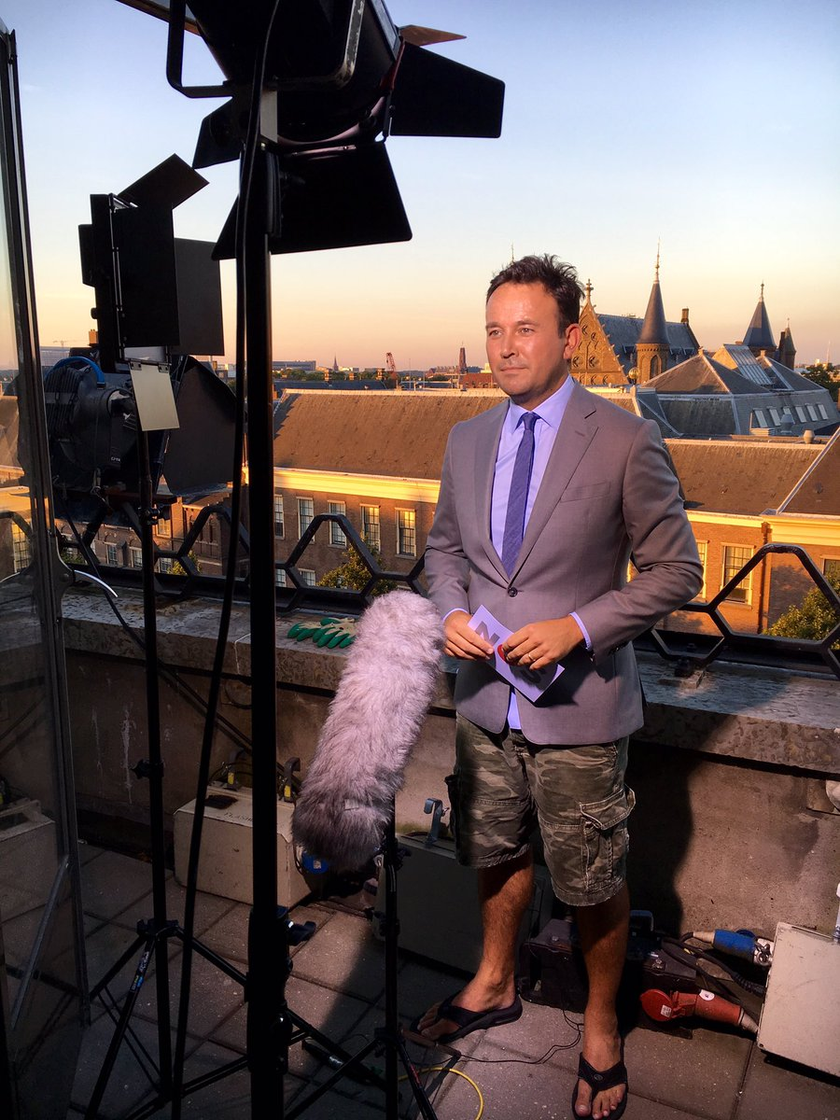
WEBCAM – TO USE OR NOT TO USE?

Slide 14
WEBCAM – TO USE OR NOT TO USE?
USING VIDEO
Creates a sense of presence, closeness, builds rapport
More engagement
Provides non-verbal information
May contribute to higher discomfort / anxiety
Higher cognitive demands
Requires certain skills (eg eye contact)
NOT USING VIDEO
Lack of non-verbal clues may inhibit comprehension
Fewer distractions and channels to monitor
Less self-consciousness
More privacy
Appropriate for slower connections
(based on Kozar, 2015)

Slide 15

What’s wrong with the image?
Place your screenshot here

Slide 16

What’s wrong with the image?
Place your screenshot here

Slide 17

What’s wrong with the image?
Place your screenshot here

Slide 18

What’s wrong with the image?
Place your screenshot here

Slide 19
TIPS FOR USING VIDEO
Check the image before the lesson (Skype: Tools – Options – Video Settings), adjust it if needed.
Neutral, professional background
Clothes contrasting with the background
Camera at or slightly above eye level
Not too close: visible shoulders, extra space
Soft light from the front, no backlighting
Look into the camera, not at the screen
Move the window with your image towards your webcam or turn this feature off

Slide 20



VIDEO / AUDIO CONFERENCING SOFTWARE
Skype
Zoom
Google Hangouts, Viber, Telegram etc
Which ones have you used?

Slide 21
Skype VS Zoom
 | Skype | Zoom
Video/Audio Calls |  | 
Send files |  | 
Screensharing |  |  Can also use annotations (like a whiteboard)
Text chat |  |  Mostly during the meeting
Record | ❒ Only with third-party software | 
Schedule | ❒ | 
Share computer audio |  Depends on your computer |  Only if sharing screen

Slide 22
SKYPE
PROS
Well-known, the learners might be familiar with it
Wide range of supported platforms
Free group calls with no time limit (up to 25 people)
Instant messaging
CONS
Using a whiteboard or recording calls requires third-party software
Might not work well on older devices
Sharing system sound often won’t work properly

Slide 23
PROS
Screen sharing with annotating feature can be used as a whiteboard
Possible to schedule recurring meetings
Easy to record calls
CONS
Not as well known as Skype
System sound can be shared only when screen sharing
Chat is enabled during meetings automatically, a chat for instant messaging can be created separately
Free version has a 40 min limit on calls

Slide 24


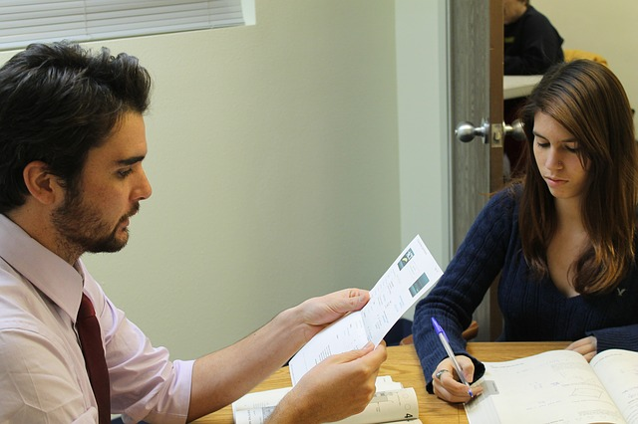

FROM A REGULAR CLASSROOM TO AN ONLINE ONE

Slide 25
FROM A REGULAR CLASSROOM TO AN ONLINE ONE
Not just what technology to use, but
how to use it to create a pedagogically sound learning environment

Slide 26
SKILLS FOR ONLINE TUTORS
Own style
Creativity and choice
Facilitating
communicative competence
Online socialization
Dealing with constraints and
possibilities of the medium
Specific technical competence for the software
Basic ICT competence
(Hampel & Stickler, 2005)

Slide 27
SKILLS FOR ONLINE TUTORS
Own style
Similar to face-to-face settings (but need adapting)
Creativity and choice
Facilitating
communicative competence
Online socialization
Dealing with constraints and
possibilities of the medium
Virtual
environment
demands
Specific technical competence for the software
Basic ICT competence
(Hampel & Stickler, 2005)

Slide 28
SKILLS FOR ONLINE TUTORS
Using traditional whiteboards and interactive ones, paper flashcards or Quizlet
Own style
Creativity and choice
Choosing and adapting activities,
New uses for tools
Facilitating
communicative competence
Applying communicative principles to online teaching
Online socialization
Creating co-presence
Miming might be difficult, but pictionary can work
Dealing with constraints and
possibilities of the medium
Specific technical competence for the software
Screensharing
Basic ICT competence
Dealing with bad
sound quality
(Hampel & Stickler, 2005)

Slide 29
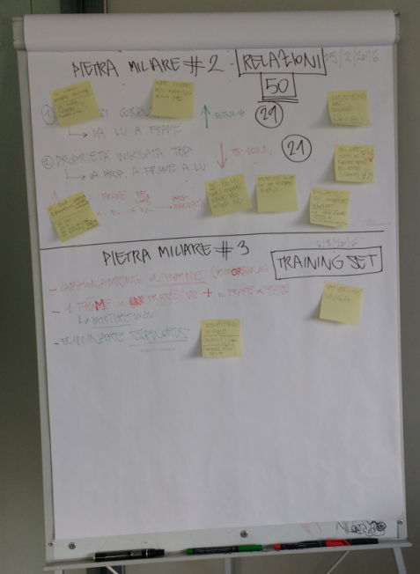
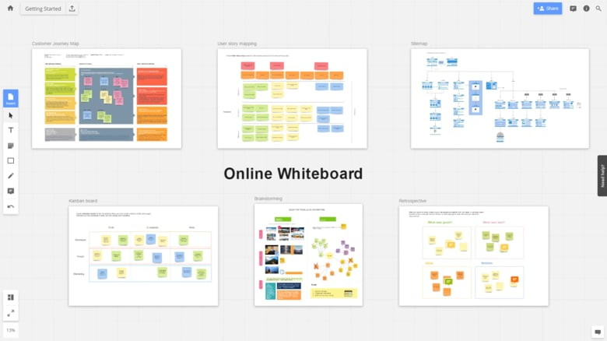

WHITE- BOARDS
Photo by Hjfocs (https://commons.wikimedia.org/wiki/User:Hjfocs)

Slide 30
ONLINE WHITEBOARDS
The teacher and the learners can see the same page in their browser and write/collaborate/interact in real time
https://realtimeboard.com/
https://idroo.com
https://awwapp.com

Slide 31
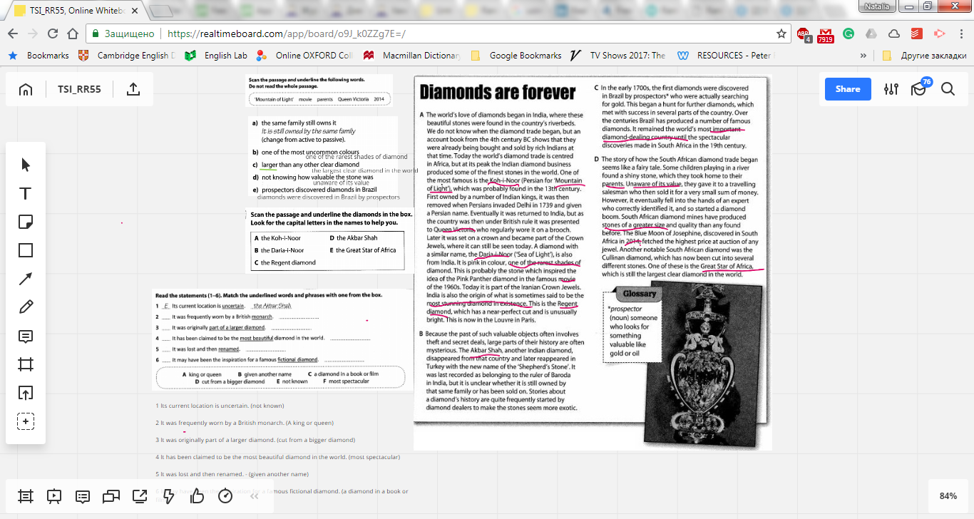
REALTIMEBOARD
Task from Timesaver for Exams: IELTS Starter: Reading (4 - 5.5) (Julie Moore and Norman Whitby) – practising reading strategies

Slide 32
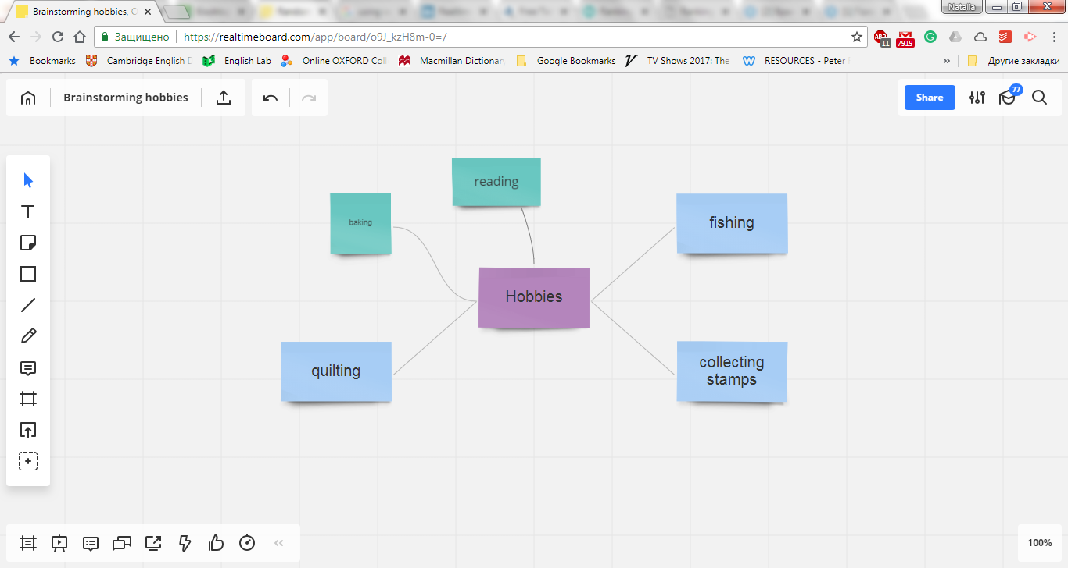
REALTIMEBOARD
You can use a template when creating a board or just create the objects you need yourself

Slide 33
Add text
Add a sticky note
Draw a shape
Add a comment

Slide 34
REALTIMEBOARD: Let’s practice
Open the board (you should have the link in your email). To be able to edit it you will need to register.
Think of one more hobby and add a sticky note to the mind map with your idea. Use the “Connection line” tool to draw a line between the central note (“Hobbies”) and your sticky note.
Add a short comment to one of the ideas: write your opinion of the hobby. (Select the “Comment tool”, left-click where you want your comment to appear and type your comment)

Slide 35
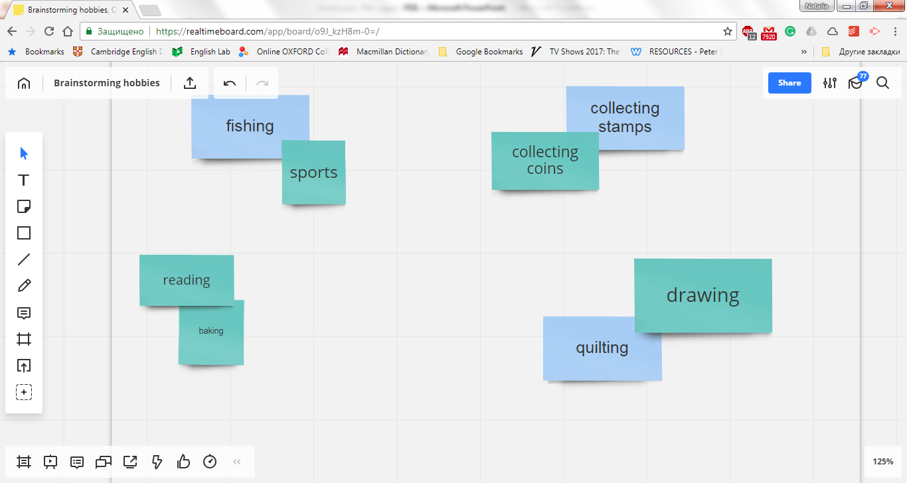
REALTIMEBOARD
The objects can be copied and/or rearranged as needed. Tip: If you want to prevent an object from moving, select it - right-click - Lock (or Ctrl-L)

Slide 36
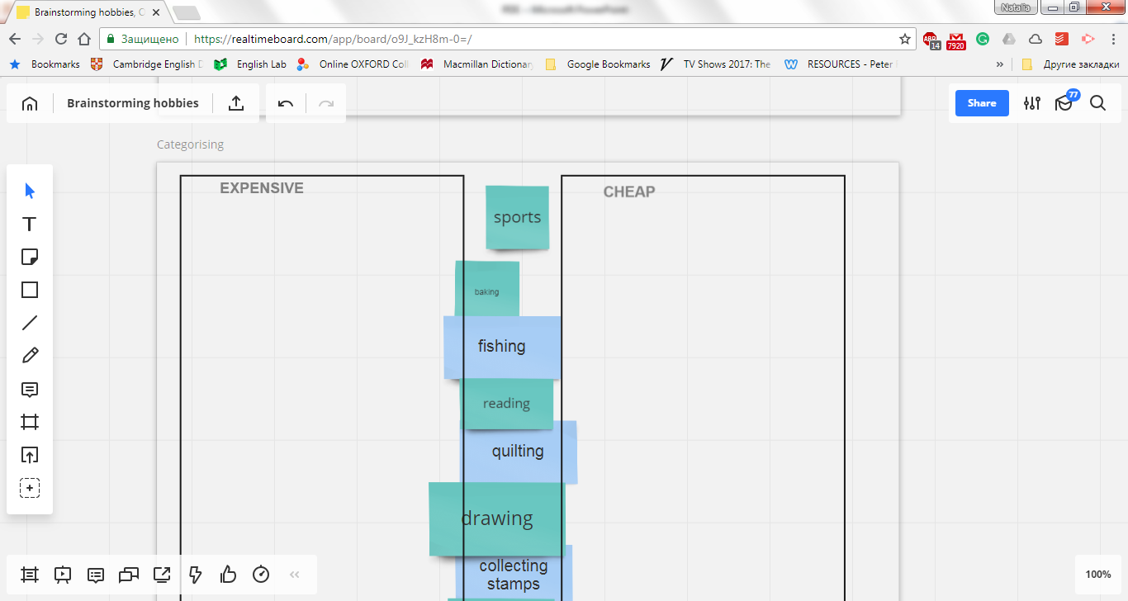
REALTIMEBOARD: Let’s practice
Rearrange the hobbies we’ve brainstormed into two categories: expensive and cheap:
Scroll down the board and you will see two rectangles. Select a sticky note and drag it to the corresponding rectangle.

Slide 37
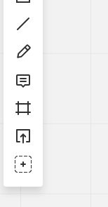
REALTIMEBOARD TIPS
You can embed pdf documents, images and videos
You can add templates (such a mind map, Venn diagram)
You can use a timer: you set it and the learner will see the countdown
You can even use boardgames
Add a document from your device or Cloud storages
Choose a template or add a video embed code

Slide 38
KEY TAKEAWAYS
Now that you have all this new information, what should you do with it?
Hardware for teaching online
Webcams: advantages, disadvantages, good practice
Communication tools
Tools to support teaching
Facilitating learning online: using possibilities and adapting activities in a principled way

Slide 39
What’s next?
Consider your next steps towards starting to teach online and share with me and other participants.
Scroll down the board and find the frame “after the webinar”. Leave your comments. Answer the following questions:
1. What was the most interesting thing you learnt?
2. What do you plan to do next?
Feel free to share your other thoughts or questions about the webinar or online teaching in general.

Slide 40

YOUR QUESTIONS

Slide 41
REFERENCES
Hampel, R., & Stickler, U. (2005) New skills for new classrooms: Training tutors to teach languages online. Computer Assisted Language Learning, 18(4), 311–326.
Kozar, O. (2015). Perceptions of webcam use by experienced online teachers and learners: a seeming disconnect between research and practice. Computer Assisted Language Learning, 29(4), 779—789
Moore, J. & Whitby, N. (2017). Timesaver for exams: IELTS starter – reading. UK, London: Scholastic.

Slide 42
CREDITS
Special thanks to all the people who made and released these awesome resources for free:
Presentation template by SlidesCarnival
Photographs by Unsplash, Pixabay

Slide 43
EXTRA RESOURCES
A presentation about using Realtimeboard in education https://www.slideshare.net/RealtimeBoard/realtimeboard-for-education

