Slide 1

Online teacher toolkit
Free apps to promote student engagement
Notes:
Kia ora. Thank you for joining me in this talk on online teacher tools.

Slide 2

Notes:
Every trade has its tools. Chefs swear by their knives. They bring their own knives to work and get very upset, I am told, if someone else uses their knives.

Slide 3

Notes:
What about teacher tools? Images of pens and pencils, scissors and flashcards, whiteboard markers and textbooks spring to mind.

Slide 4

Notes:
When we think of teaching online, however, some of these tools no longer cut it. An activity might work well face-to-face, but using it online might not be as straightforward.

Slide 5

Notes:
What I found is that it often boils down to finding the right tool for the.
I’ll point out three tools that I found useful for teaching online. They were my chefs’ knives and I did swear by them. And, unlike chefs, I won’t mind if you use them yourself!

Slide 6
miro.com
Online whiteboard for visual collaboration
Free educator accounts
Infinite board, can be divided into frames
Frames to organize content or student work
Notes:
My favourite tool for online facilitation is Miro. It was created for the corporate world, but can be easily adapted for language lessons as well. The students can see text, images, videos that you add to the board, and can edit it in real-time, during the lesson, or outside the lesson. If you register with your institutional address, you can get a free educator account. If you use your personal email to register, you can still use it for free, but the features are more limited.
Each Miro board is infinite. It is a lot of space, so you organize the board into sections using frames. I often had one frame per lesson or per part of a lesson. It is also possible to prepare a frame in one board and copy it onto another. I liked having a storage board to hold my pre-prepared frames and another board for the content the students were working on.
You can even assign each student or a group of students a particular frame and monitor in real-time how they are doing. This eliminates some of the uncertainty that is often present in online lesson, this way you can literally and figurately ensure that everyone is on the same page

Slide 7
miro.com
Voting and timer
Templates
Mind map
Notes:
Educational accounts have access to the voting feature and timer. I also love the templates: have a look at them for some ideas on how the board can be used. For instance, there is a template with warmups for any meeting or lesson. Miro also has an easy way to create mind maps.

Slide 8
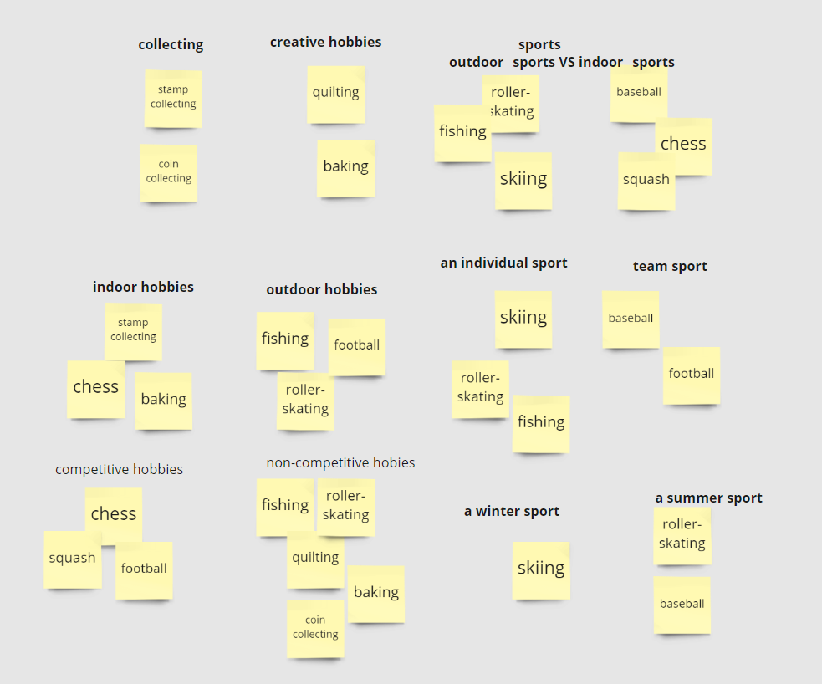
Stickers
Idea generation
Brainstorming
Categorizing
Notes:
Just a couple of ideas of how Miro can be used. Here we were looking at the topic of leisure activities and were generating ideas before a writing task. Students added their ideas on stickers, and then reorganized the stickers into various categories. Stickers can be quickly copied, so it was easy to add the same word to a couple of categories at once.

Slide 9
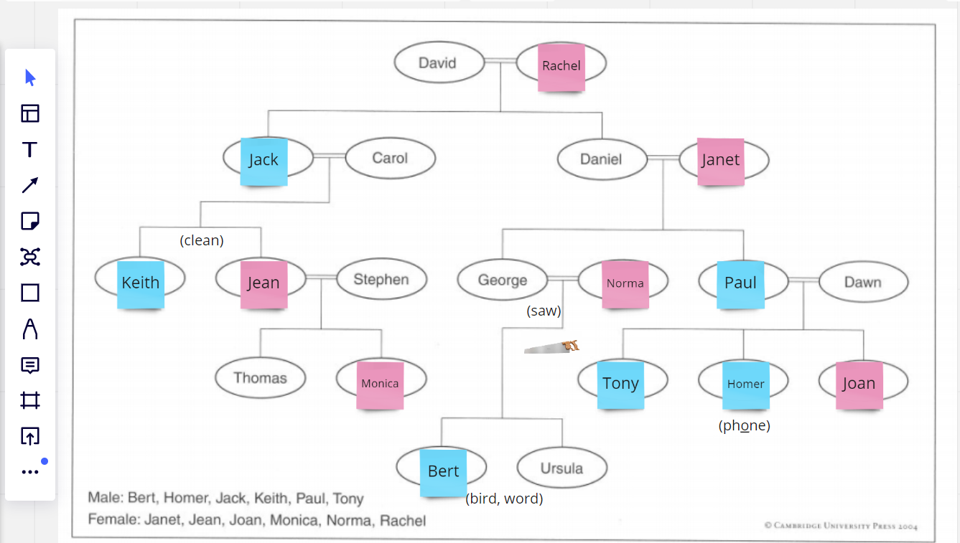
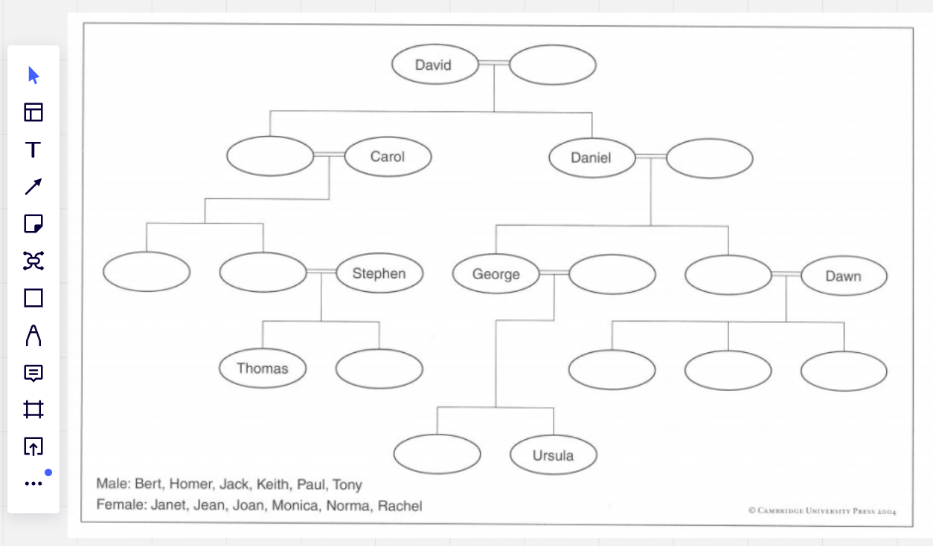
Hands-on
Text, sticker, pen tools
A photocopiable activity
Prepare in a frame, copy and reuse
(Source: Pronunciation Practice Activities by M. Hewings)
Notes:
Since students can edit the board, you can have some hands-on activities during the lessons or assign them as homework. Here, I used a photocopiable pronunciation activity. I copied it onto the board, then added some stickers, and the students could move them across the board. You can see a miniature image of a saw and some other words that I added during the lesson. These were for sounds that proved difficult for my students.

Slide 10

Collaborative writing…
Notes:
Students can certainly use Miro for collaborative writing activities. You might also be familiar with using Google Docs or Microsoft Word online for online collaboration, but a tool that is a bit more lightweight - Etherpad

Slide 11

or speaking? Etherpad!
Notes:
Actually, an etherpad document can be used as a notebook for any kind of activity your students do in an online lesson. A change made by any of its users will be immediately visible to everyone. To get started, you basically need to create a document and invite students to it. Etherpad does not require authorization and anyone who has the link can access the document, so, it might not be the most secure option for collaboration. But it is very easy to set up and simple to use.

Slide 12
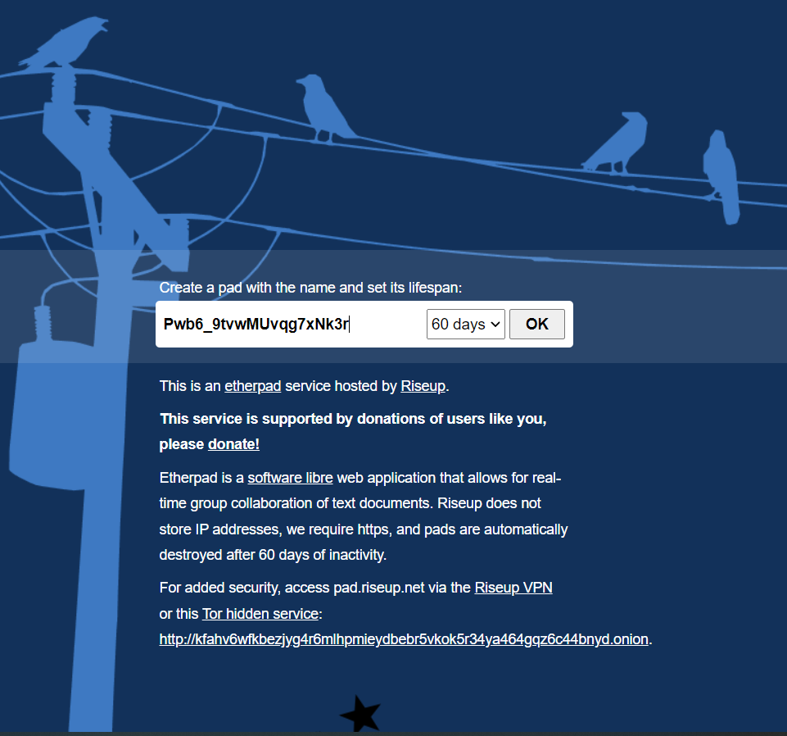
Set up a pad
https://pad.riseup.net/
Create a pad and select its lifespan
Check out etherpad.com for a list of other sites
Notes:
Etherpad is free and open-source; and there are many websites where you can create a pad, for example pad.riseup.net. Just give your pad a name and specify its lifespan, then you can share the link to the pad with your students.

Slide 13
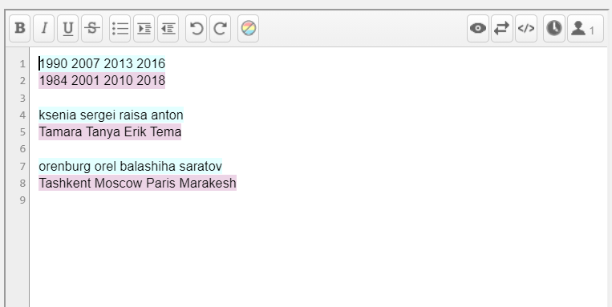
Guess what your partner's words mean. Ask a follow-up question.
1 a cafe or bar you go to
2 a neighbour you know
3 a type of music you like
4 the house you live in
5 a subject you interested in
6 a TV programme you watch
7 a favourite possession you have
8 the place you work or study
EXAMPLE
A: "Maxim"... Is Maxim a neighbour you know?
B: No, not really! It's a cafe I often go to.
A: How long have you been going there?
B: I've been going there for 6 years.
Notes:
Here we were using it for a simple speaking activity: students were writing their one-word answers, and their partner was guessing what the words meant.
Each user’s contributions will have a different colour, so, if you are using etherpad for collaborative writing, you can see at a glance if you students have contributed equally
You can also use Etherpad to gather anonymous responses from students or for voting.

Slide 14

Notes:
Moving on to my third tool. I find collaborative crosswords, or half a crossword activities quite useful, and for a while I’d been looking for a way to do those during an online class. You can, certainly, create a crossword (there are some online services for that), but how to make it usable for a pair or a group during an online lesson?

Slide 15
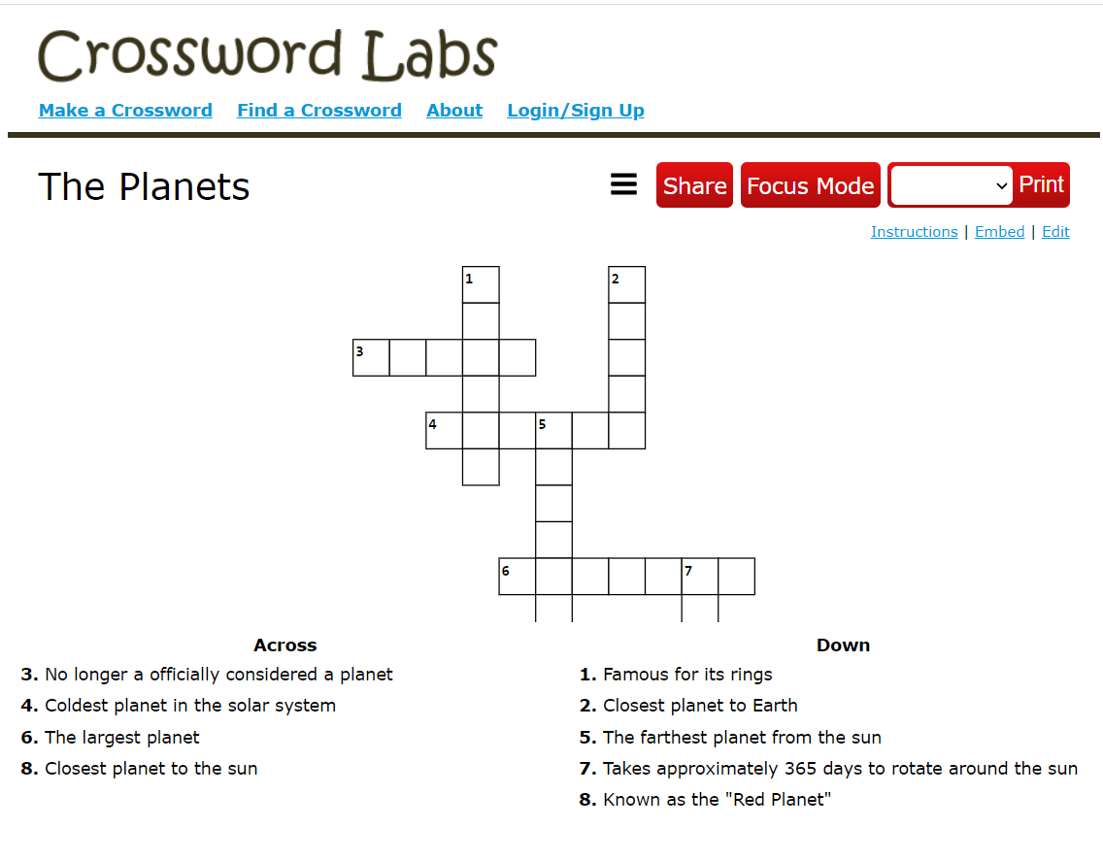
crosswordlabs.com
Notes:
Meet Crosswordlabs – a free and easy crossword maker. Each crossword has its own link, so once you share the link with students, they can complete it online. Please note that unlike the two other tools I talked about, this one does not synchronise what each user is seeing. So each student will have their own version that they fill in online.

Slide 16
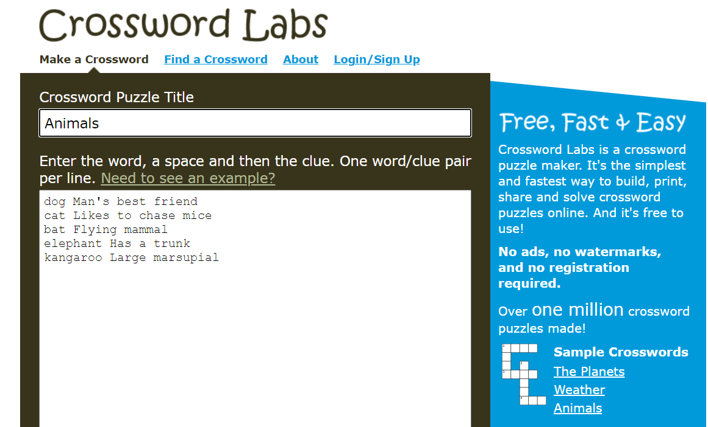
Creating a crossword
Notes:
Unfortunately, crosswordlabs does not allow you to create half-crosswords easily, but I have found a workaround.
You’ll start by creating a crossword. It’s very straightforward: give it a title and type in a list of words and clues. Each line will have a word followed by a clue. Then save the crossword. Be sure to set a passcode before saving – this way you’ll be able to edit your crossword later, and you’ll need to edit it!

Slide 17
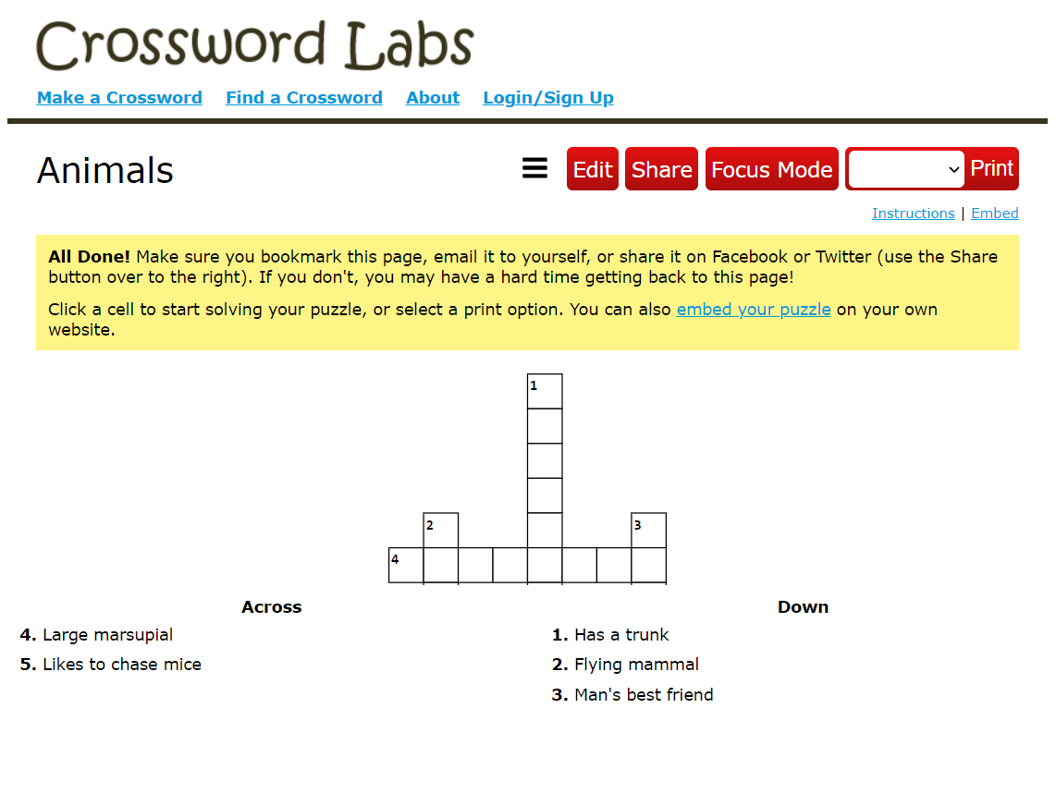
Notes:
The newly created crossword will have a list of clues at the bottom. [[click]] Copy them into a separate document – you are going to send those to students. Then go back to Edit your crossword [[click]] (there is an edit button at the top).

Slide 18
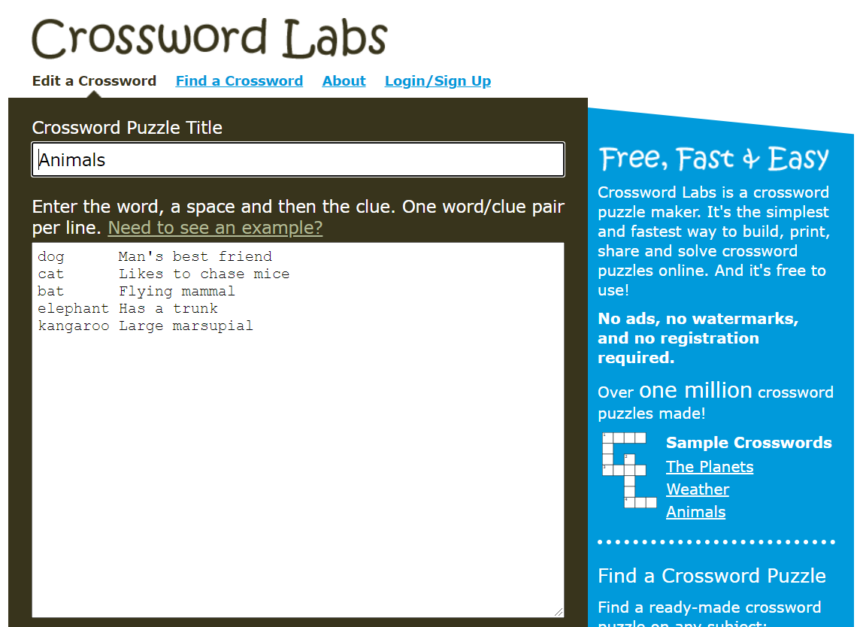
Notes:
Back in the editing mode, we’ll replace the clues with some symbol - a hyphen or an underscore. This will look something like this…

Slide 19

Notes:
Now save your crossword again.

Slide 20
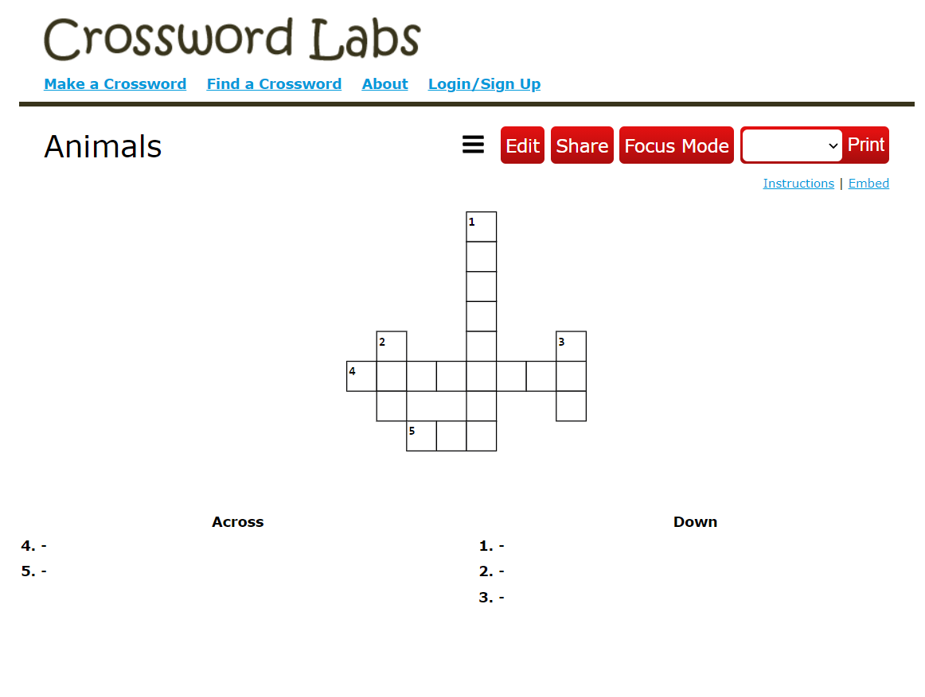
Notes:
You will now see the crossword without the clues below it. But the words are still here, and the students can type them. That is why you needed to copy the clues earlier. Now Student A gets half of the clues, student B another half, and off they go. An online half a crossword activity!

Slide 21
Online teacher toolkit
Free apps to promote student engagement
Thank you!
Questions? Please feel free to reach out!
Email: me@nataliakurikova.com
URL: nataliakurikova.com
Notes:
This is it. Thank you for watching my talk and I hope you’ll find these tools useful. Please feel free to reach out – happy to answer any questions or just talk about all things teaching online.

